Slide 1
CS499 - Open Source software development
Tests and CI
Dr. Igor Steinmacher
e-mail: Igor.Steinmacher@nau.edu
Twitter: @igorsteinmacher
Based on the material of @gustavopinto and @filipesaraiva

Slide 2
What are unit tests?
Functions/methods to test the behavior of small(est) parts of a software in isolation
May or may not be executed in production
The goal is to validate that each small unit of software will have the expected behavior
Basically:
Input the data in a method and check if it is returning the correct result

Slide 3
Why?
Check if pieces are working after you change the system
Unit testing increases confidence in changing/ maintaining code.
Point out defects while developing
Enforces more reusable code → You need to go modular
Debugging is easier (sometimes)
Helps you finding where the issue is

Slide 4
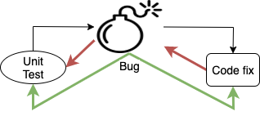
What else?
First level of software testing
The smallest testable parts of a software are tested
Validate each unit of the software
Each test unit must be fully independent

Slide 5
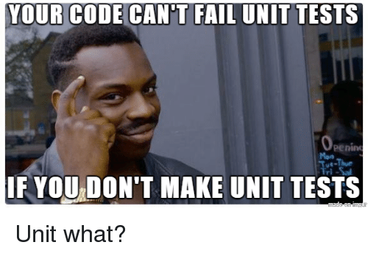

Slide 6
Unit Test: How To?
There are multiple modules we can use
We will focus on creating Testcases using `unittest` (part of Python standard package)
Import the module:
import unittest
Import the file/function(s) you are testing:
import function from file
Create a class that extends Testcase
class myTest(unittest.TestCase):
...
Convert the tests into methods
Using assertions

Slide 7
Unit Test: Assert What? Who?
Asserts: Methods we can call to evaluate our functions
assertEqual()- Tests that the two arguments are equal in value.
assertNotEqual()- Tests that the two arguments are unequal in value.
assertTrue()- Tests that the argument has a Boolean value of True.
assertFalse()- Tests that the argument has a Boolean value of False.
assertIs()- Tests that the arguments evaluate to the same object.
assertIsNot()- Tests that the arguments do not evaluate to the same object.
assertIsNone()- Tests that the argument evaluates to none.
assertIsNotNone()- Tests that the argument does not evaluate to none.
assertIn()- Tests that the first argument is in the second.
assertNotIn()- Tests that the first argument is not in the second.
assertIsInstance()- Tests that the first argument (object) is an instance of the second (class).
assertRaises()- Tests that Python raises an exception when we call the callable with positional/ keyword arguments we also passed to this method.
More here:
https://kapeli.com/cheat_sheets/Python_unittest_Assertions.docset/Contents/Resources/Documents/index

Slide 8
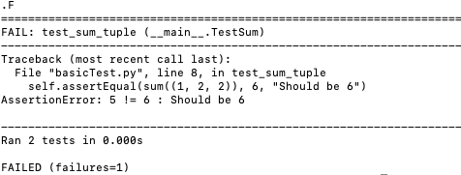
Unit Tests: Basic!
import unittest class TestSum(unittest.TestCase):
def test_sum(self):
self.assertEqual(sum([1, 2, 3]), 6, "Should be 6")
def test_sum_tuple(self):
self.assertEqual(sum((1, 2, 2)), 6, "Should be 6")
if __name__ == '__main__’:
unittest.main()

Slide 9
Unit Tests: Basic!
def is_prime(number):
for element in range(number):
if (number % element == 0):
return False
return True
def print_next_prime(number):
index = number
while True:
index += 1
if is_prime(index):
print(index)
The smallest unit here is the is_prime
function (print_next_time uses it)
Let’s test it using something that we know
Is 5 prime?
Thanks
https://jeffknupp.com/blog/2013/12/09/improve-your-python-understanding-unit-testing/

Slide 10
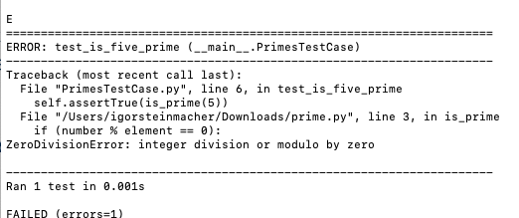
Unit Tests: Basic!
def is_prime(number):
for element in range(number):
if (number % element == 0):
return False
return True
def print_next_prime(number):
index = number
while True:
index += 1
if is_prime(index):
print(index)
import unittest
from prime import is_prime
class PrimesTestCase(unittest.TestCase):
def test_is_five_prime(self):
self.assertTrue(is_prime(5))
#self.assertEquals(is_prime(5), True)
if __name__ == '__main__’:
unittest.main()

Slide 11
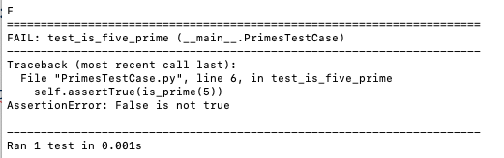
Unit Tests: Fixing…
def is_prime(number):
for element in range(1, number):
if (number % element == 0):
return False
return True
def print_next_prime(number):
index = number
while True:
index += 1
if is_prime(index):
print(index)
import unittest
from prime import is_prime
class PrimesTestCase(unittest.TestCase):
def test_is_five_prime(self):
self.assertTrue(is_prime(5))
if __name__ == '__main__’:
unittest.main()

Slide 12
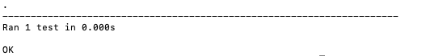
Unit Tests: Fixing…
def is_prime(number):
for element in range(2, number):
if (number % element == 0):
return False
return True
def print_next_prime(number):
index = number
while True:
index += 1
if is_prime(index):
print(index)
import unittest
from prime import is_prime
class PrimesTestCase(unittest.TestCase):
def test_is_five_prime(self):
self.assertTrue(is_prime(5))
if __name__ == '__main__’:
unittest.main()

Slide 13
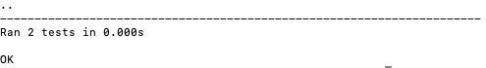
What to test?
Known cases (like we’ve done)
def is_prime(number):
for element in range(2, number):
if (number % element == 0):
return False
return True
def print_next_prime(number):
index = number
while True:
index += 1
if is_prime(index):
print(index)
import unittest
from prime import is_prime
class PrimesTestCase(unittest.TestCase):
def test_is_five_prime(self):
self.assertTrue(is_prime(5))
def test_is_four_prime(self):
self.assertFalse(is_prime(4))
if __name__ == '__main__’:
unittest.main()

Slide 14
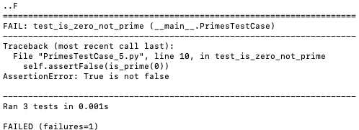
What to test?
Edge cases (ZERO!!!)
def is_prime(number):
for element in range(2, number):
if (number % element == 0):
return False
return True
def print_next_prime(number):
index = number
while True:
index += 1
if is_prime(index):
print(index)
import unittest
from prime import is_prime
class PrimesTestCase(unittest.TestCase):
def test_is_five_prime(self):
self.assertTrue(is_prime(5))
def test_is_four_prime(self):
self.assertFalse(is_prime(4))
def test_is_zero_not_prime(self):
self.assertFalse(is_prime(0))

Slide 15
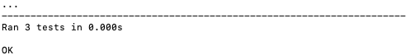
What to test?
def is_prime(number):
if number in (0, 1):
return False
for element in range(2, number):
if (number % element == 0):
return False
return True
def print_next_prime(number):
index = number
while True:
index += 1
if is_prime(index):
print(index)
import unittest
from prime import is_prime
class PrimesTestCase(unittest.TestCase):
def test_is_five_prime(self):
self.assertTrue(is_prime(5))
def test_is_four_prime(self):
self.assertFalse(is_prime(4))
def test_is_zero_not_prime(self):
self.assertFalse(is_prime(0))

Slide 16
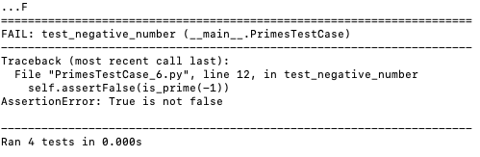
What to test?
def is_prime(number):
if number in (0, 1):
return False
for element in range(2, number):
if (number % element == 0):
return False
return True
def print_next_prime(number):
index = number
while True:
index += 1
if is_prime(index):
print(index)
import unittest
from prime import is_prime
class PrimesTestCase(unittest.TestCase):
...
def test_negative_number(self):
self.assertFalse(is_prime(-1))
self.assertFalse(is_prime(-2))
self.assertFalse(is_prime(-3))
self.assertFalse(is_prime(-4))
self.assertFalse(is_prime(-5))
self.assertFalse(is_prime(-6))
self.assertFalse(is_prime(-7))
self.assertFalse(is_prime(-8))
self.assertFalse(is_prime(-9))

Slide 17
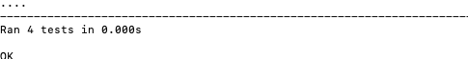
What to test?
def is_prime(number):
if number <= 1:
return False
for element in range(2, number):
if (number % element == 0):
return False
return True
def print_next_prime(number):
index = number
while True:
index += 1
if is_prime(index):
print(index)
import unittest
from prime import is_prime
class PrimesTestCase(unittest.TestCase):
...
def test_negative_number(self):
self.assertFalse(is_prime(-1))
self.assertFalse(is_prime(-2))
self.assertFalse(is_prime(-3))
self.assertFalse(is_prime(-4))
self.assertFalse(is_prime(-5))
self.assertFalse(is_prime(-6))
self.assertFalse(is_prime(-7))
self.assertFalse(is_prime(-8))
self.assertFalse(is_prime(-9))

Slide 18
CS499 - Open Source software development
Tests and CI
Dr. Igor Steinmacher
e-mail: Igor.Steinmacher@nau.edu
Twitter: @igorsteinmacher
Based on the material of @gustavopinto and @filipesaraiva

Slide 19
What is Continuous Integration?
Continuous Integration is a set of related practices that guide development teams to implement minor changes and check in code to version control repositories frequently.

Slide 20
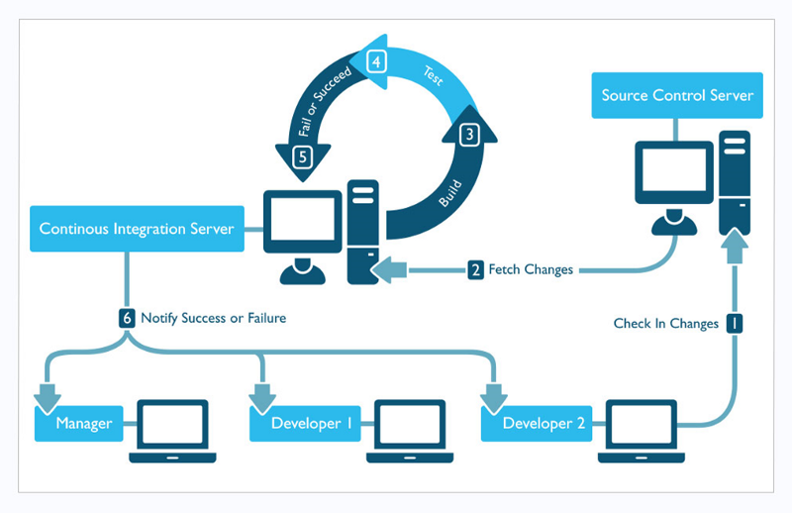

Slide 21
What is it for?
Find and investigate bugs faster
Improve Software Quality
Reduce the time to validate and release the software

Slide 22
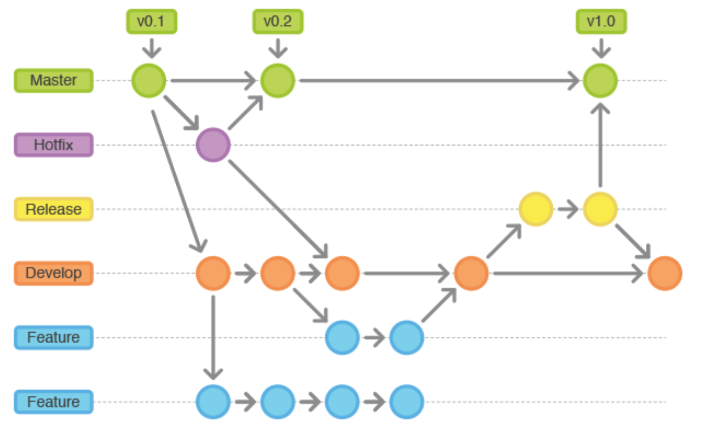
When to use it?
When there is a long time until branches are merged with the master
When there is a problem to integrate with the master
When the integration gets more complicated after each change

Slide 23
What do you need?
Version Control
single repositor
Automated build process
Command line compilation (IDE build)
Team acceptance
Integration is not exactly a tool (but a practice)
Team used to develop in the master
All need to share the same vision

Slide 24
“Requirements” for CI
Frequent check-ins (commits)
Throughout the day
Smaller changes
Less chances of failing
A comprehensive automated test set
Keep the compilation and test process short
Increase the chances of running the CI locally with the time is small

Slide 25

Travis CI
Integration with users/projects on GitHub
Free for public repos
Easy to use
Support for Mac, Windows, iOS

Slide 26
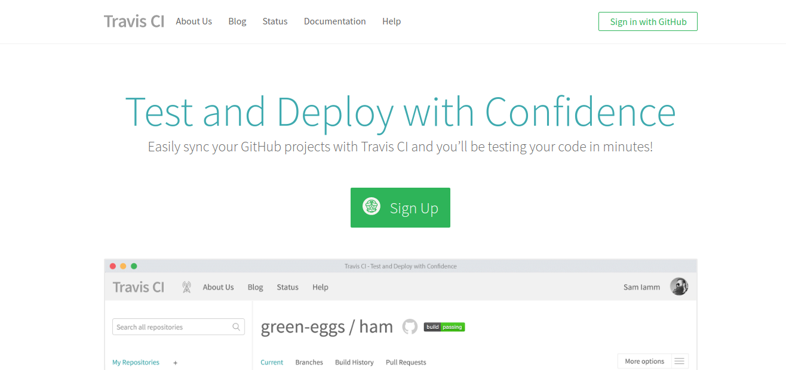

Slide 27
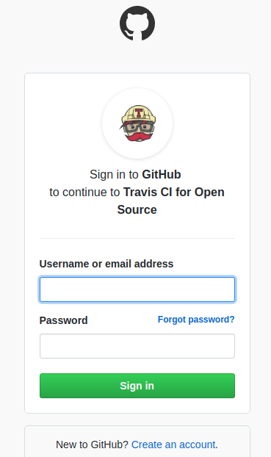
Sign up to Travis

Slide 28
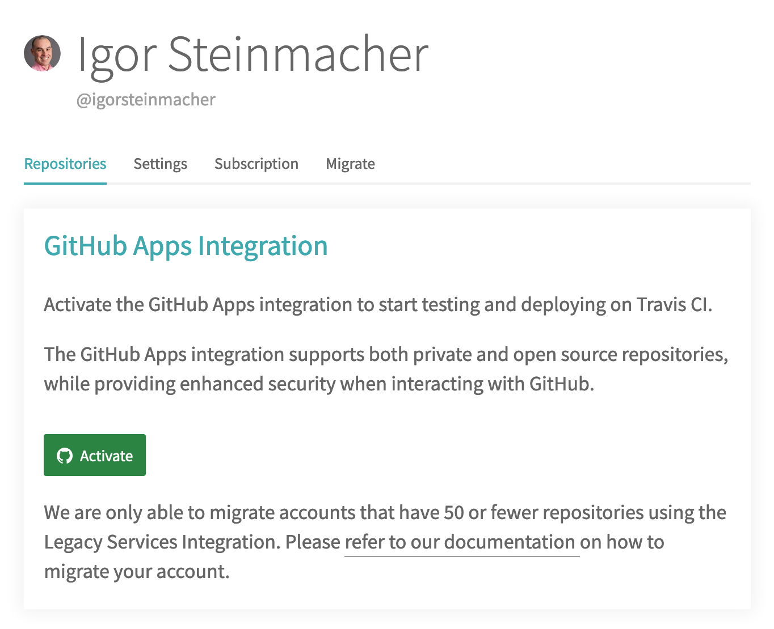

Slide 29
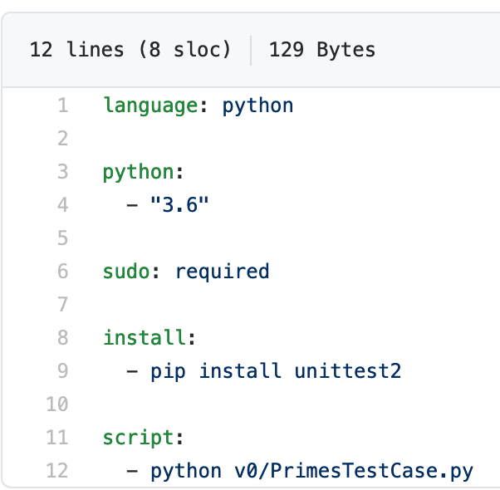
On GitHub: your .travis.yml

Slide 30
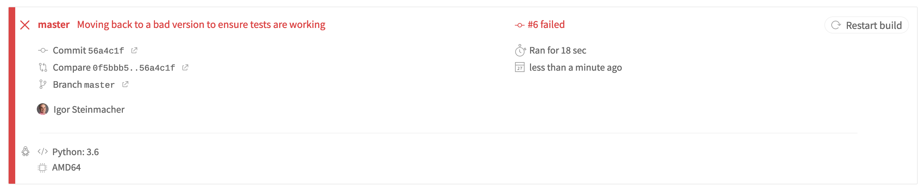

Slide 31
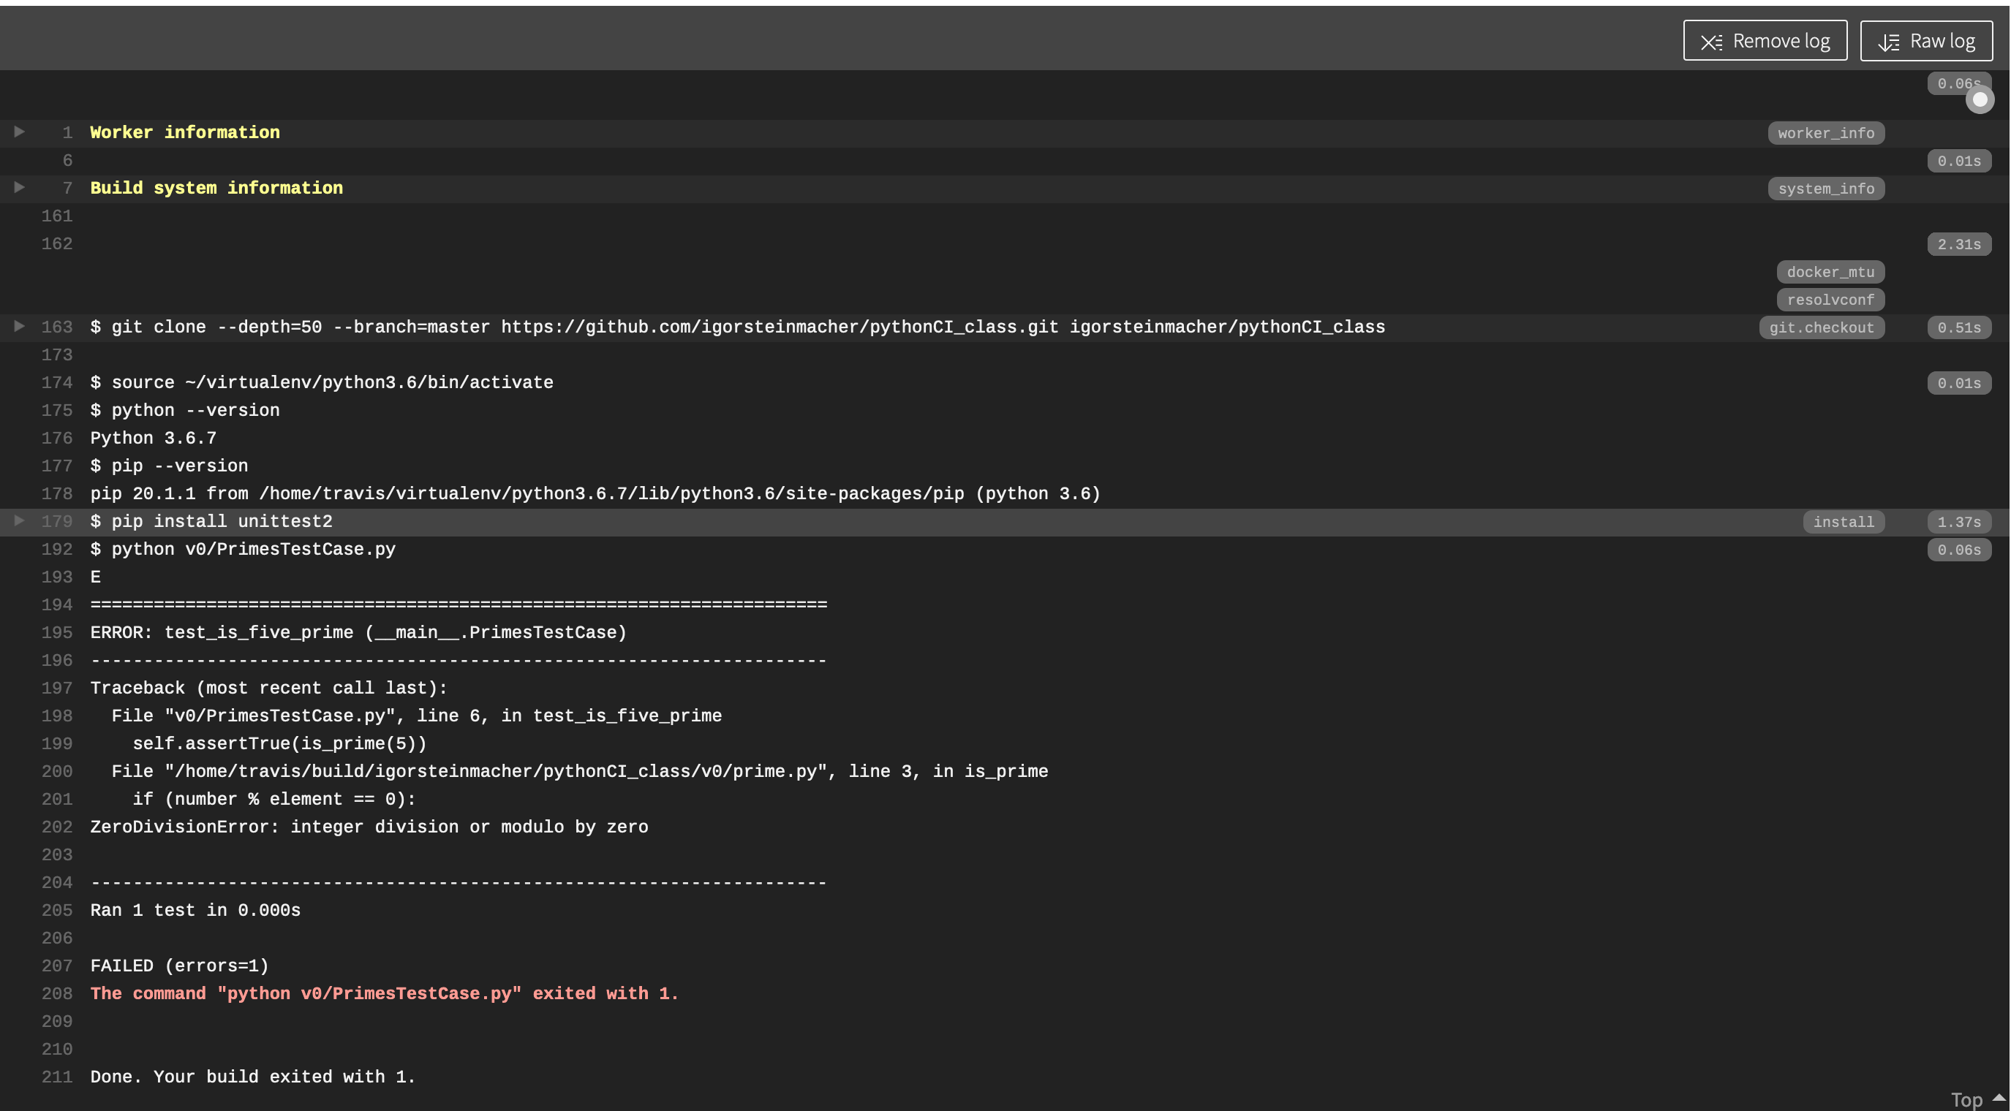
Oh No!

Slide 32
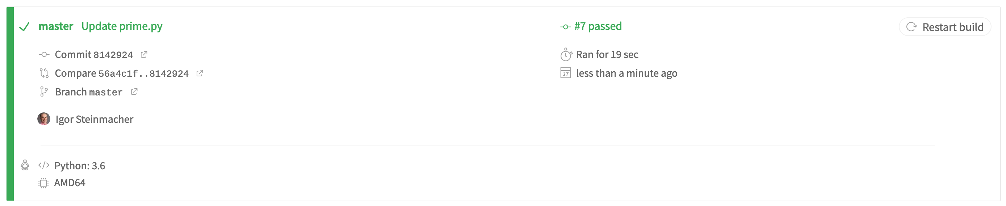
Changed the code and commiTted back

Slide 33
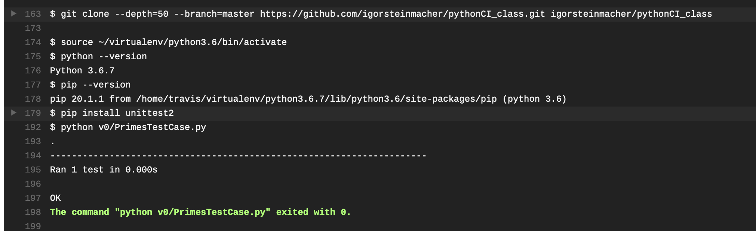
YES!

